Slide 1
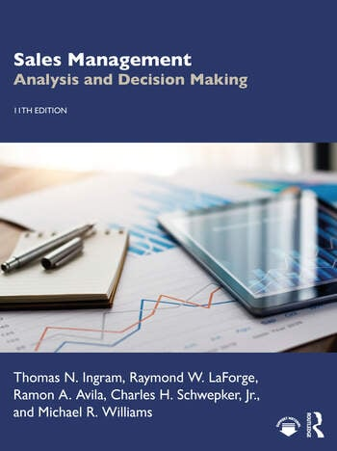
Appendix 4
Developing Forecasts
Notes:
A meteorologist used all the latest technology to predict a bright and sunny day in the mid-80s. It rained most of the day and never got warmer than 70 degrees. The weather forecast missed the mark on this particular occasion, but the meteorologist will continue to make weather forecasts and to work on improving weather forecasting procedures.
Sales managers face a situation similar to that of the meteorologist. The business environment is complex and dynamic, there are a number of forecasting methods available, and often forecasts are incorrect. Nevertheless, sales managers must continue to forecast and to work on improving their forecasting procedures.

Slide 2

Why Forecast?
All Sales Management decisions are based on some type of forecast.
Forecasts are used to help:
Determine salesforce size
Design territories
Establish sales quotas and selling budgets
Determine sales compensation levels
Evaluate salesperson performance
Evaluate prospective accounts
Freepik.com
Notes:
Why is forecasting so important to sales managers? In one sense, all sales management decisions are based on some type of forecast. The sales manager decides on a certain action because he or she thinks that it will produce a certain result. This expected result is a forecast, even though the sales manager may not have quantified it or may not have used a mathematical forecasting procedure. More specifically, forecasts provide the basis for the following sales management decisions:
Determining salesforce size
Designing territories
Establishing sales quotas and setting budgets
Determining sales compensation levels
Evaluating salesperson performance
Evaluating prospective accounts

Slide 3
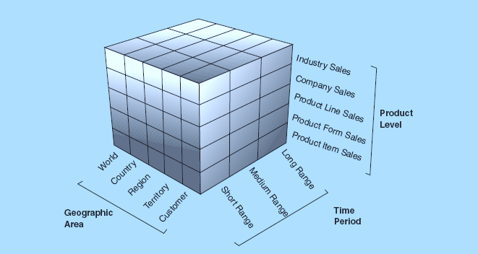
Defining the Forecast
Notes:
FORECASTING BY SALES MANAGERS
Although top management levels are most concerned with total firm forecasts, sales managers are typically interested in developing and using forecasts for specific areas, such as accounts, territories, districts, regions, and/or zones. For example, a district sales manager would be concerned with the district forecast as well as forecasts for individual territories and accounts within the district. There are, however, different types of forecasts that sales managers might use in different ways, and different approaches and methods might be used to develop these forecasts.
As illustrated in this Figure, at least three factors must be defined when referring to a forecast: the product level, the geographic area, and the time period. The figure presents 90 different forecasts that might be made, depending on these factors. Thus, when using the term forecast, sales managers should be specific in defining exactly what is being forecast, what geographic area is being targeted, and what period is being forecast.

Slide 4
Types of Forecasts
Best Possible Results
Expected Results for Given Strategy
Industry Level
Market Potential
Market Forecast
Firm Level
Sales Potential
Sales Forecast
Notes:
Types of Forecasts
The term forecast is ordinarily used to refer to a prediction for a future period. Although this usage is technically correct, it is too general for managerial value.
A useful way for viewing what is being forecast is presented in this Exhibit. This exhibit suggests that it is important to differentiate between industry and firm levels and to determine whether the prediction is for the best possible results or for the expected results given a specific strategy. Four different types of forecasts emerge from this classification scheme:
Market potential—the best possible level of industry sales in a given geographic area for a specific period.
Market forecast—the expected level of industry sales given a specific industry strategy in a given geographic area for a specific period.
Sales potential—the best possible level of firm sales in a given geographic area for a specific period.
Sales forecast—the expected level of firm sales given a specific strategy in a given geographic area for a specific period.
Notice that the geographic area and period are defined for each of these terms and that a true sales forecast must include the consideration of a specific strategy. If a firm changes this strategy, the sales forecast should change also.
As an example, assume that you are the district sales manager for a firm that markets personal computers (PCs) to organizational buyers. Your district includes Missouri, Kansas, Iowa, and Nebraska. You are preparing forecasts for 2024.
You might first try to assess market potential. This market potential forecast would be an estimate of the highest level of PC sales by all brands in your district for 2024.
Then, you might try to develop a market forecast, which would be the expected level of industry PC sales in your district for 2024. This forecast would be based on an assumption of the strategies that would be used by all PC firms operating in your district. If you think that new firms are going to enter the industry or that existing firms are going to leave it or change their strategies, your industry forecast will change.
Another type of forecast might be a determination of the best possible level of 2024 sales for your firm’s PCs in the district. This would be a sales potential forecast.
Finally, you would probably want to predict a specific level of district sales of your firm’s PCs given your firm’s expected strategy. This would result in a sales forecast that would have to be revised whenever strategic changes were made.
***Because different types of forecasts convey different information, sales managers use certain types for specific sales management decisions.
Forecasts of market potential and sales potential are most often used to identify opportunities and to guide the allocation of selling efforts.
Market potential provides an assessment of overall demand opportunity available to all firms in an industry.
Sales potential adjusts market potential to reflect industry competition and thus represents a better assessment of demand opportunity for an individual firm.
Both of these forecasts of potential can be used by sales managers to determine where selling effort is needed and how selling effort should be distributed.
For example, as discussed earlier, designing territories requires an assessment of market potential for all planning and control units. Specific territories are then designed by grouping planning and control units together and evaluating the equality of market potential across the territories.

Slide 5
Top-Down vs. Bottom-Up Forecasting
Bottom Up
Top Down
Forecast made at the “front-line” level and then aggregated up the levels of the organization.
Forecast made at the business unit level then broken down by zone, region, district, territory, and account forecast.
Notes:
Top-down approaches typically consist of different methods for developing company forecasts at the business unit level. Sales managers then break down these company forecasts into zone, region, district, territory, and account forecasts.
Bottom-up approaches, by contrast, consist of different methods for developing sales forecasts for individual accounts. Sales managers then combine the account forecasts into territory, district, region, zone, and company forecasts.
The top-down and bottom-up approaches represent entirely different perspectives for developing forecasts, although some forecasting methods can be used in either approach. However, the focus is on the most popular forecasting methods for each approach.

Slide 6
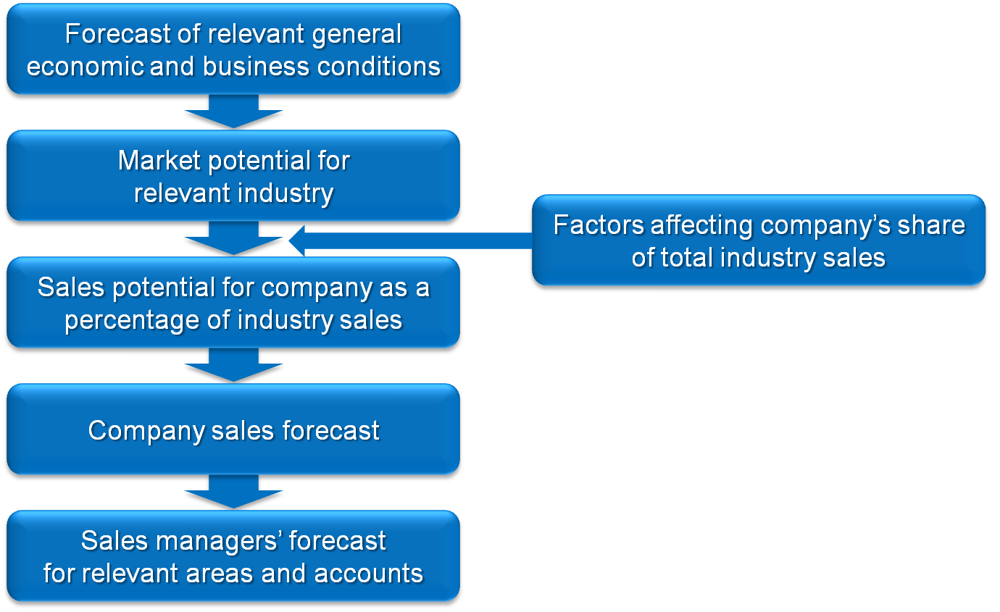
Top-Down Approach
Notes:
Top-down approaches typically consist of different methods for developing company forecasts at the business unit level. Sales managers then break down these company forecasts into zone, region, district, territory, and account forecasts.

Slide 7
Bottom-Up Approach
Company Sales Forecast
Combined into district, region, and zone forecasts
Combined into territory forecasts
Salespersons’ forecasts of accounts
Notes:
Bottom-up approaches, by contrast, consist of different methods for developing sales forecasts for individual accounts. Sales managers then combine the account forecasts into territory, district, region, zone, and company forecasts.

Slide 8
Company Forecasting Methods
Moving Averages
Uses historical averages to forecast future sales.
Averages are calculated using a predetermined number of previous periods (e.g., two-year moving average; four-year moving average).
Exponential Smoothing
Weighted moving average.
Usually most recent period is weighted heavier.
Decomposition Methods
Breakdown historical sales data into four components (trend, cycle, seasonal, erratic).
Evaluate the components and then reincorporate to create a forecast.
Notes:
Although a variety of methods are available for developing company forecasts, this discussion is limited to three popular time series methods: moving averages, exponential smoothing, and decomposition methods.

Slide 9
Moving Averages Forecast Example
Year | Actual Sales | Two-Year | Four-Year
2016 | $8,400,000
2017 | $8,820,000
2018 | $8,644,000 | $8,610,000
2019 | $8,212,000 | $8,732,000
2020 | $8,622,000 | $8,428,000 | $8,520,000
2021 | $9,484,000 | $8,418,000 | $8,574,000
2022 | $9,674,000 | $9,054,000 | $8,740,000
2023 | $10,060,000 | $9,579,000 | $8,998,000
2024 | ? | $9,867,000 | $9,460,000
Sales Forecast for next year = Actual sales for past two or four years /
Number of years…using two or four years
Notes:
Moving averages is a relatively simple method that develops a company forecast by calculating the average company sales for previous years.
Thus, the company sales forecast for next year is the average of actual company sales for the past three years, past six years, or some other number of years.
An example of calculating a moving averages company sales forecast for two- and four-year time frames is presented in the Exhibit.
This exhibit shows that the forecast predicted for 2018 was derived by adding actual sales in 2016 of $8,400,000 to actual sales in 2017 of $8,820,000 and then dividing by two ([$8,400,000 + $8,820,000]/2 = $8,610,000). This was repeated to get the projected forecast for each successive year.
To get the forecast for 2024, actual sales for 2022 and 2023 were added together and divided by two ([$9,674,000 + $10,060,000]/2 = $9,867,000).
The same procedure is used to calculate the four-year moving average, but rather than using two years of actual sales and dividing by two, four years are summated and then divided by four (e.g., sales forecast for 2024 is [$8,622,000 + $9,484,000 + $9,674,000 + $10,060,000]/4 = $9,460,000).
As illustrated in this example, the moving averages method is straightforward and requires simple calculations. Management must, however, determine the appropriate number of years to include in the calculations. In addition, this method weights actual company sales for previous years equally in generating the forecast for the next year. This equal weighting may not be appropriate if company sales vary substantially from year to year or if there are major differences in the business environment between the most recent and past years.

Slide 10
Moving Averages Forecast Exercise
You have been asked to calculate 2024 sales. Your company uses a four-year moving average to forecast total U.S. company sales. You are provided with the following information:
Year Actual Sales
2016 $783,620,000
2017 780,500,000
2018 793,740,000
2019 796,850,000
2020 794,025,000
2021 797,400,000
2022 801,800,000
2023 806,775,000
2024 ????
1) Forecast total company U.S. sales for 2024.
2) What would the forecast be if the company used a two-year moving average to forecast company sales?
Notes:
1) The forecasted sales for 2024, using a four-year moving average, is $800,000,000.
A four-year moving average is calculated by averaging the sales from the last four years…2020 to 2023:
(794,025,000 + 797,400,000 + 801,800,000 + 806,775,000) / 4 = 800,000,000
3,200,000,000 / 4 = 800,000,000
2) The forecasted sales for 2024, using a two-year moving average is $804,287,500.
A two-year moving average is calculated by averaging the sales from the last two years…2022 to 2023:
(801,800,000 + 806,775,000) / 2 = 804,287,500
1,608,575,000 / 2 = 804,287,500

Slide 11
Exponential Smoothing Forecast Example
Year | Actual Sales | α = 0.2 | α = 0.5 | α = 0.8
2016 | $8,400,000
2017 | $8,820,000 | $8,400,000 | $8,400,000 | $8,400,000
2018 | $8,644,000 | $8,484,000 | $861,000 | $8,736,000
2019 | $8,212,000 | $8,516,000 | $8,627,000 | $8,662,000
2020 | $8,622,000 | $8,455,000 | $8,420,000 | $8,302,000
2021 | $9,484,000 | $8,488,000 | $8,521,000 | $8,558,000
2022 | $9,674,000 | $8,687,000 | $9,003,000 | $9,299,000
2023 | $10,060,000 | $8,884,000 | $9,339,000 | $9,599,000
2024 | ? | $9,119,000 | $9,700,000 | $9,968,000
Sales forecast for next year = (α)(actual sales this year) + (1 − α)(this year’s sales forecast)
$9,119,000 = (0.2 x $10,060,000 + 0.8 x $8,884,000) / 2
$8,884,000 = sales that were forecast for the current year; 0.8 = 1 - 0.2
Notes:
Sales forecast for next year = (α)(actual sales this year) + (1 − α)(this year’s sales forecast)
$9,119,000 = (0.2 x $10,060,000 + 0.8 x $8,884,000) / 2
$8,884,000 = sales that were forecast for the current year; 0.8 = 1 - 0.2
Exponential smoothing is a type of moving averages method, except that company sales in the most recent year are weighted differently from company sales in past years.
An example of the exponential smoothing method is provided in this Exhibit. This exhibit shows that the sales forecast predicted for 2024 using an alpha of 0.2 was derived by multiplying actual sales in 2023 by 0.2 and adding it to 0.8 times the forecasted sales in 2023 ([.2 × $10,060,000 + .8 × $8,884,000] = $9,119,000). Each of the previous years’ forecasts was derived in the same manner.
A critical aspect of this method involves determining the appropriate weight (α) for this year’s company sales. This is typically accomplished by examining different weights for historical sales data to determine which weight would have generated the most accurate sales forecasts in the past. Based on the analysis in the Exhibit, management should probably use a weight of 0.8 for this year’s company sales.

Slide 12
Comparison of Forecasts using Moving Averages and Exponential Smoothing

Slide 13
Decomposition Method Example
Assume that various analyses have decomposed previous sales data into the following components:
A 5% growth in sales is predicted due to basic developments in population, capital formation, and technology (trend component). A 10% decrease in sales is expected due to a business recession (cycle component). Increased tensions in the Middle East are expected to reduce sales by an additional 5% (erratic events component). Sales results are reasonably consistent throughout the year except for the fourth quarter, where sales are expected to be 25% higher than the other quarters (seasonal component).
A marketer of consumer products might recombine the different components in the following manner to forecast sales for 2024:
Sales in 2023 were $10,060,000. The trend component suggests that 2023 sales will be $10,563,000 ($10,060,000 × 1.05). However, incorporating the expected business recession represented in the cycle component changes the sales forecast to $9,506,700 ($10,563,000 × 0.90). The annual sales forecast is reduced to $9,031,365 when the erratic events component is introduced ($9,056,700 × 0.95). Quarterly sales forecasts would initially be calculated as $2,257,841 ($9,031,365 ÷ 4). However, incorporating the seasonal component suggests fourth-quarter sales of $2,822,302 ($2,257,841 × 1.25) and sales for the other three quarters of $2,069,688 ($9,031,365–$2,822,302 ÷ 3).
Notes:
Decomposition methods involve different procedures that break down previous company sales data into four major components: trend, cycle, seasonal, and erratic events.
These components are then reincorporated to produce the sales forecast.
An example of a decomposition method is presented in the Exhibit. Notice that the trend, cycle, and erratic events components are incorporated into the annual forecast but that the seasonal component is used only when forecasting sales for periods of less than a year, such as months or quarters. Decomposition methods are sound conceptually but often require complex statistical approaches for breaking down the company sales data into the trend components. Once this decomposition has been completed, it is relatively easy to reincorporate the components into the development of a company forecast.

Slide 14
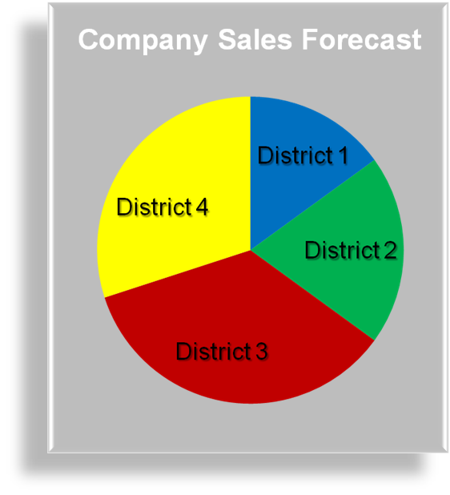
Breakdown Methods
Use factors influencing sales at the region, district, and territory levels to adjust forecasts made at the business unit level (top-down method).
Factors should be continuously evaluated.
Examples: Buying Power Index; Household Penetration; FAN/Flu
**not required to know how to calculate for exam
Notes:
BREAKDOWN METHODS
Once sales managers receive a company forecast, they can use different market factor methods to break it down to the desired levels. Market factor methods typically involve identifying one or more factors that are related to sales at the zone, region, district, territory, or account levels and using these factors to break down the overall company forecast into forecasts at these levels.
One approach is for a firm to develop a buying power index for its specific situation. For example, a general aviation aircraft marketer developed a buying power index for its products in each county in the United States.
The basic formula was:
Index = (5I + 3AR + 2P) ÷ 10
where
I = Percentage of U.S. disposable income in county
AR = Percentage of U.S. aircraft registrations in county
P = Percentage of U.S. registered pi lots in county
These calculations produced an index for each county. The index calculated for each county can then be multiplied by the total company sales forecast to break it into a forecast for each county. The firm could take U.S. forecasts provided by the industry trade association and convert them to market and sales forecasts for each county by using their calculated indices and market shares.

Slide 15
Even Allocation vs Breakdown Method
Company Sales Forecast = $1,000,000
Region A Portion= 0.33
Forecast = $333,333
Region B Portion = 0.33
Forecast = $333,333
Region C Portion = 0.34
Forecast = $333,334
EVEN
Company Sales Forecast = $1,000,000
Region A Breakdown Factor = 0.20
Forecast = $200,000
Region B Breakdown Factor = 0.30
Forecast = $300,000
Region C Breakdown Factor = 0.50
Forecast = $500,000
BREAKDOWN

Slide 16

Bottom-Up Approach Methods
Survey of Buyer Intentions
Survey buyers’ purchasing intentions.
Aggregate buyer intentions.
Jury of Executive Opinion
Executives or other experts estimate sales at the
account level.
Estimates are averaged or otherwise agreed
upon to generate a forecast.
Delphi (a form of jury of executive opinion)
The “jury” is anonymous, and estimates are redistributed for revision.
The “jury” reviews and revises estimates until consensus is reached.
Salesforce Composite
Salespeople create forecasts for their accounts and territories.
Forecasts are aggregated.
Sales cycle and opportunity stage forecasting.
Freepik.com
Notes:
Implementing the bottom-up approach requires various methods to forecast sales to individual accounts and the combination of these account forecasts into territory, district, region, zone, and company forecasts.
The survey of buyer intentions method is any procedure that asks individual accounts about their purchasing plans for a future period and translates these responses into account forecasts. The intended purchases by accounts might be obtained through mail surveys, telephone surveys, personal interviews, or other approaches. For example, companies such as Dow Chemical and HP have asked their business customers for feedback regarding intended future needs. At times, forecasts based on customer intentions may be distorted due to buyers’ unwillingness to put much effort into predicting future needs. Moreover, buyers are often unwilling to reveal plans for selling a vendor’s product out of fear competitors may retaliate if they find out.
The jury of executive opinion method involves any approach in which executives of the firm use their expert knowledge to forecast sales to individual accounts. Separate forecasts might be obtained from managers in different functional areas. These forecasts are then averaged or discussed by the managers until a consensus forecast for each account is reached. Team-based approaches such as this are believed to result in more accurate long-range industry-level forecasts than individually based approaches.
The Delphi method is a structured type of jury of executive opinion method. The basic procedure involves selection of a panel of managers from within the firm. Each member of the panel submits anonymous forecasts for each account. These forecasts are summarized into a report that is sent to each panel member. The report presents descriptive statistics concerning the submitted forecasts with reasons for the lowest and highest forecasts. Panel members review this information and then again submit anonymous individual forecasts. The same procedure is repeated until the forecasts for individual accounts converge into a consensus. Because this procedure involves written rather than verbal communication, such negatives as domination, undue conservatism, and argument are eliminated, while team members benefit from one another’s input.
The salesforce composite method involves various procedures by which salespeople provide forecasts for their assigned accounts, typically on specially designed forms (see Figure 4A.3), electronically via computer, or through the company’s CRM system. At Cisco Systems, reps submit data electronically to a company database that provides information about their pipelines, including opportunity size, customer technology requirements, and competitors. Managers then use this data to develop weekly, monthly, and quarterly forecasts. There are some popular variations of the salesforce composite method. Sales cycle forecasting uses the mean length of the sales cycle to predict when deals will close. This helps salespeople predict how much they expect to sell during a certain period. With opportunity stage forecasting, salespeople calculate the probability of closing a future deal at each stage (e.g., prospecting, qualified, quote/proposal, negotiation, close) in the sales pipeline. By multiplying the probability of winning a sale (based on the stage of the deal) by the deal’s potential sales, and then adding this up for each account, salespeople can calculate their expected sales revenue for a period. Research results suggest that salesperson forecasts can be improved by developing detailed instructions about the forecasting procedures and providing salespeople with detailed information about their accounts and feedback concerning the accuracy of previous forecasts.

Slide 17
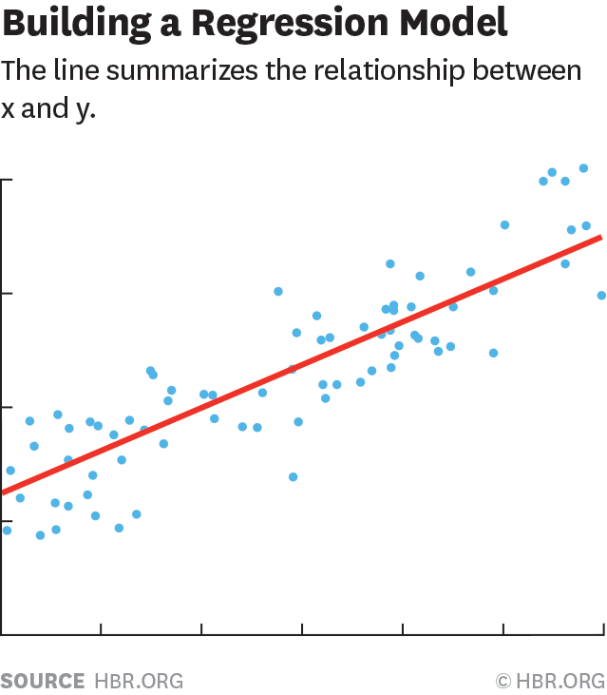
Forecasting with Regression Analysis
Statistical technique using predictor variables (factors) to forecast sales.
May be complex.
Requires collection of predictor variable data.
Analysis may be linear or logarithmic.

Slide 18
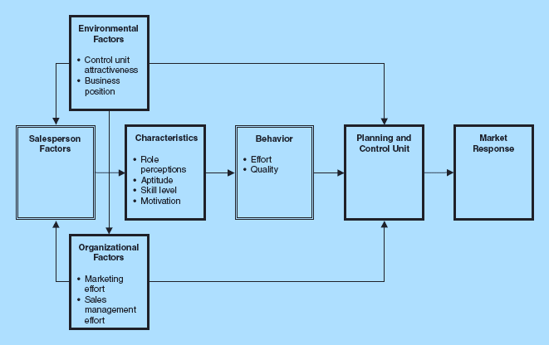
Market Response Framework
Notes:
A market response framework to guide this type of approach is presented in the Figure. Depending on the planning and control unit of interest (territory, district, region, or zone), different determinants of market response (e.g., sales, market share) might be important. However, these determinants can be classified as either environmental, organizational, or salesperson factors. Once the determinant and market response factors are identified, their values for each planning and control unit in the previous period must be measured.
These are the types of factors that affect market response for any planning and control unit, whether it be accounts, territories, districts, regions, or zones. Market response might be profits, market share, or some other response, but sales is usually the market response variable of interest to sales managers.

Slide 19
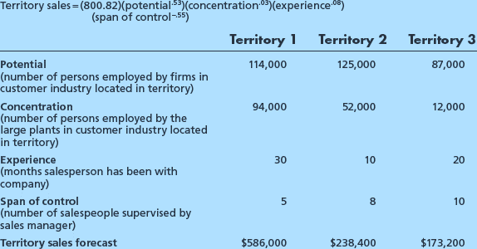
Regression Model Examples
Notes:
EXAMPLE:
The environmental factors are potential and concentration
The salesperson factor is experience, and
The organizational factor is span of control.
The data are for three territories and are used in the model to generate sales forecasts for each territory individually.
This regression model indicates that the higher the territory potential, account concentration, and level of salesperson experience are, the higher the territory sales will be.
The larger the span of control is, the lower the territory sales. The exponents in the model suggest that territory sales are most affected by territory potential and span of control. Thus, the regression model generates a specific sales forecast for each territory, and it also provides information concerning relationships between determinant factors and sales.

Slide 20
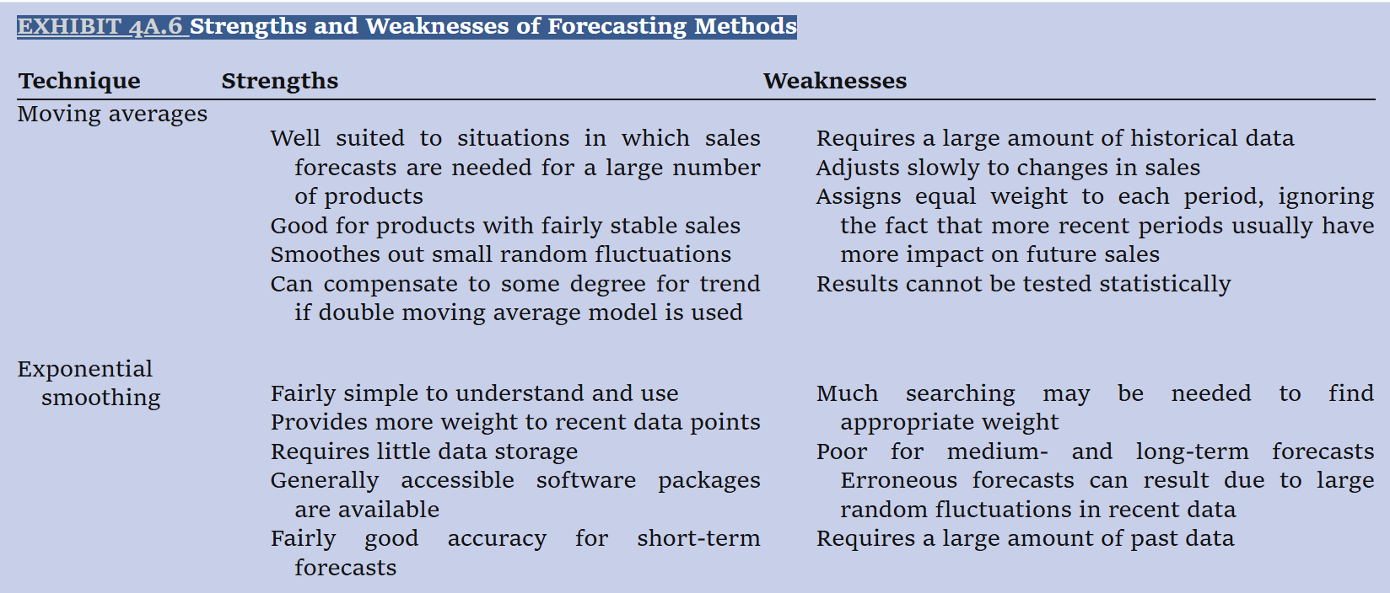
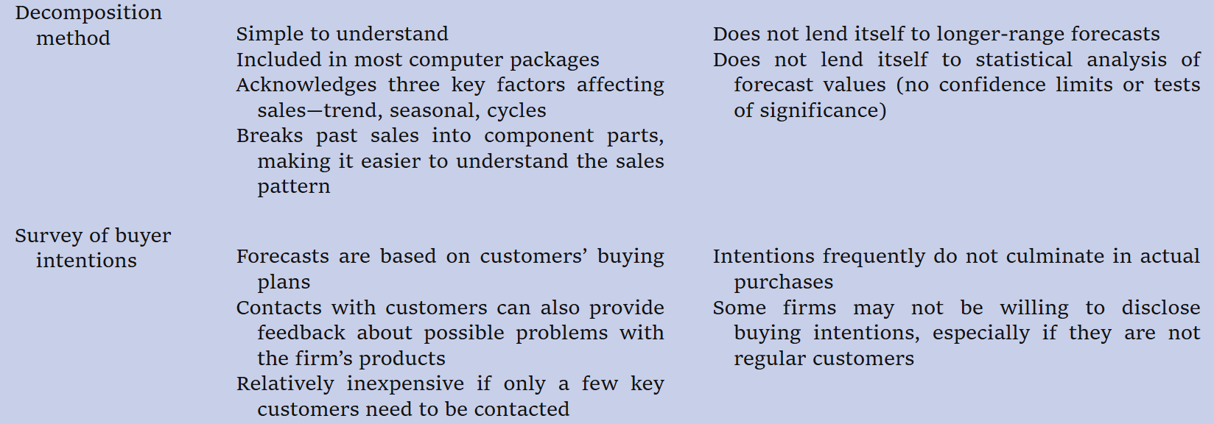
Strengths & Weaknesses of Methods

Slide 21
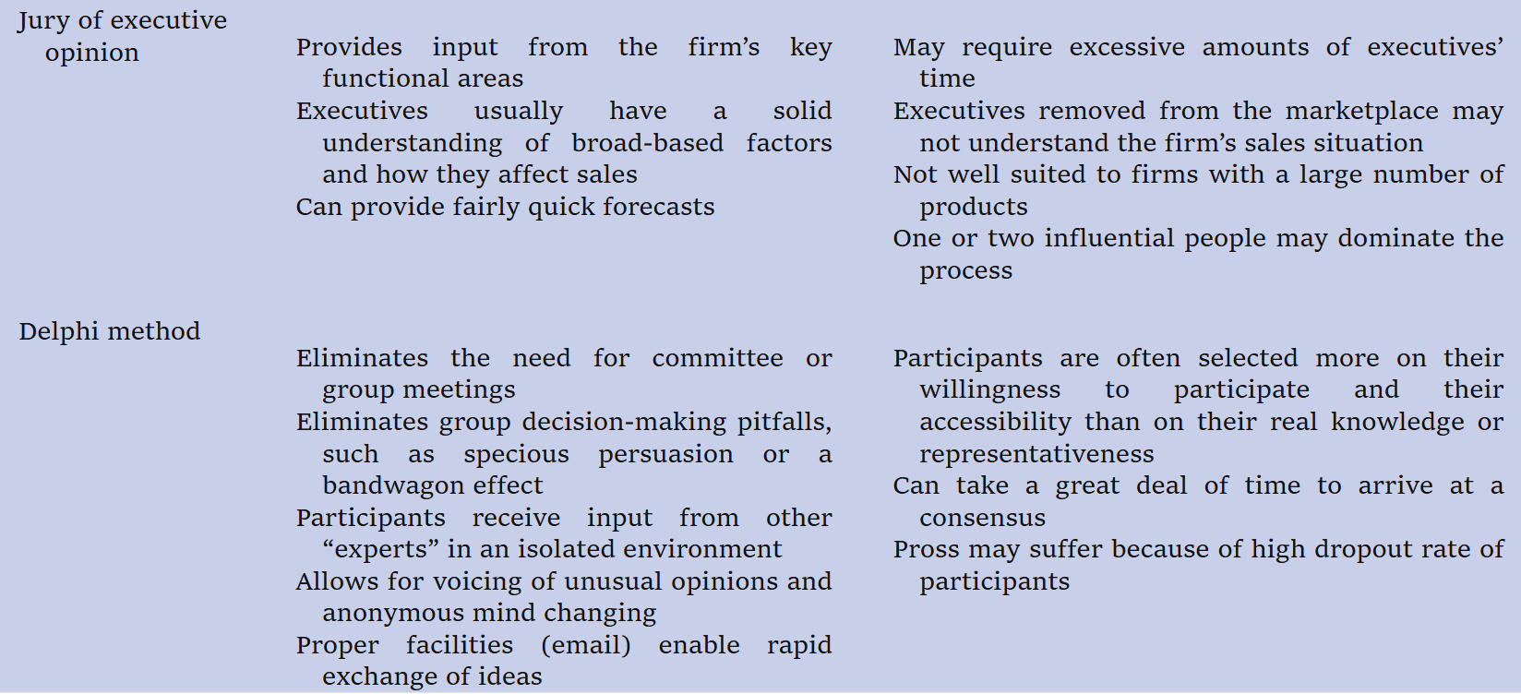
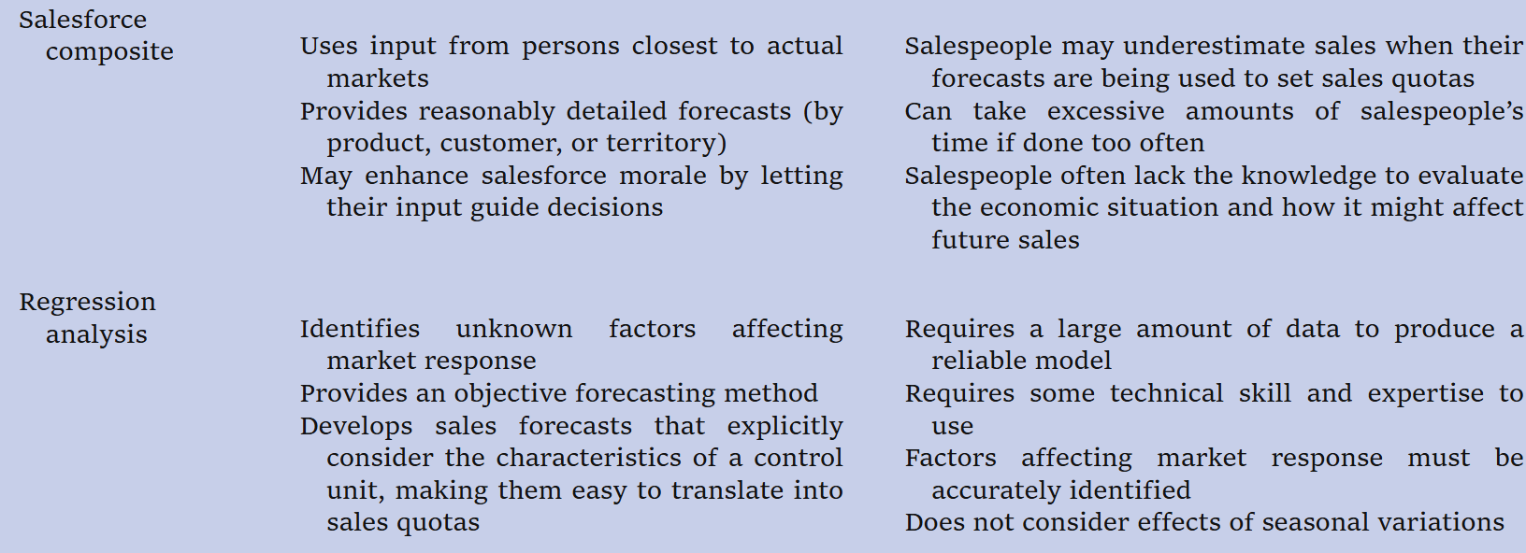
Technique Strengths Weaknesses

